Slide 1
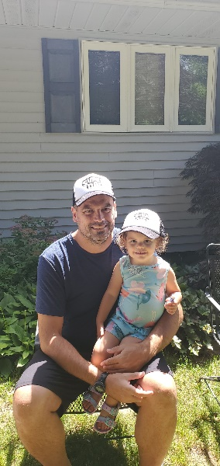
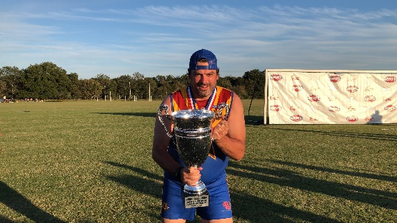
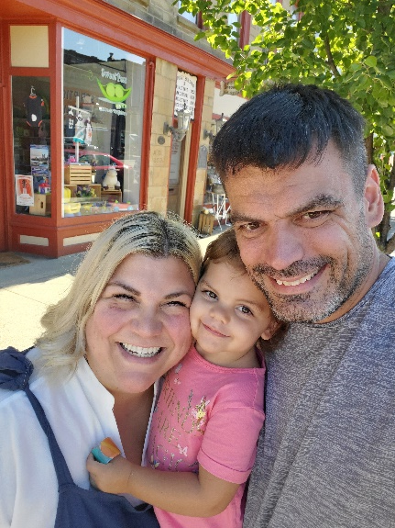


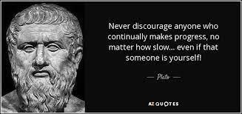
Welcome
Mr. Owen
7th Grade ELA

Slide 2
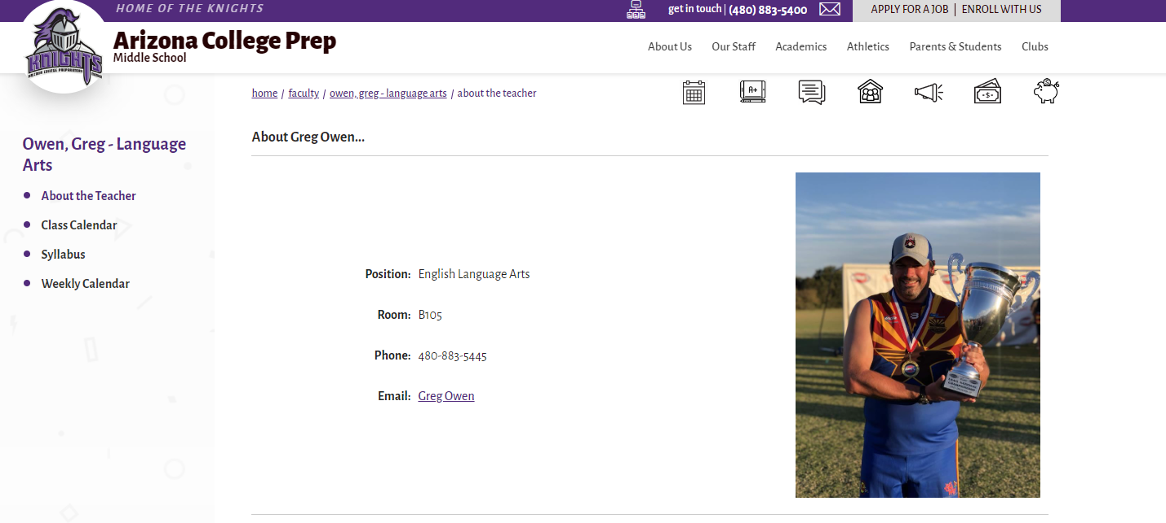
Find basic class information here, including Web Blast archives, assignment calendar, and major dates. Google Classroom has materials as well

Slide 3
How you can contact me:
CHECK WEB PAGE FOR MORE INFORMATION
Best means of contact is always email.
Email owen.gregory@cusd80.com
Phone: 480-883-5445
Tutoring Schedule: Mon & Thu 7:15am-bell
  - Additional times are available by appointment
  - Missed tests need to be taken outside of class time
      Students need to check or schedule with me about other dates and times for availability. There may be additional times to make-up tests with other 7th Grade Teachers as well.

Slide 4
TURNITIN.COM
All major writings will also need to be submitted to Turnitin.com
- Please, do not leave without handout ☺
EACH CLASS PERIOD HAS A DIFFERENT CLASS ID#

Slide 5
Late Work:
All homework is due at the beginning of the class period the day it is due.
  - stay organized
  - max score of 80 percent is turned in within 24hrs
After the 1 day late, the grade is reduced by 50% for up to one week from due date.
  - Zero score and not accepted after one week
  COMPLETION ASSIGNMENTS MAY NOT BE TURNED IN FOR LATE CREDIT UNLESS ABSENT.

Slide 6
COMPLETION ASSIGNMENTS
  COMPLETION PRACTICE/HOMEWORK/HOMESTUDY may not be turned in late because it is usually related to the material being taught/practiced/discussed the next school day
  - Not completing the assigned homestudy will affect the learning associated with the curriculum upon arriving in class the following day.
    GRADES FOR COMPLETION ASSIGNMENTS:
    FULL POINTS (TOTALLY COMPLETE)
    ANSWERS COMPLETE/NOT FOLLOWING DIRECTIONS (PARTIAL POINTS)
    INCOMPLETE (BLANK/S) A ZERO

Slide 7
Absences:
ALWAYS check the Web Blast and Mr. Owen’s Website under “Assignment Calendar” Tab for information on assignments and curriculum covered in class
Check Google Classroom for materials as well
Missed Quiz/test check with Mr. Owen and arrange a time to make up the test before/after school within a week of the original date given. If Mr. Owen is not available, we can arrange a time with another teacher.
**Students will not be able to make up any work if they have an unexcused absence. They will get a “0” for those assignments. (DISTRICT POLICY)
It is the student’s responsibility to follow up on all missing work by checking the web page assignment calendar and/or the classroom calendar located at the back of the room “8th Grade Handouts”.
All long-term projects and assignments due dates will still be required even if student is absent on the date due. Any paper copy materials associated with project will be due upon return to school.

Slide 8
7th Grade Reading List:
Pearson—My Perspectives (All reading materials provided for students in class.)
Novels
1st Quarter – The Outsiders by S.E. Hinton
2nd Quarter - MyPerspectives textbook
3rd Quarter - Roll of Thunder, Hear My Cry by Mildred D. Taylor
4th Quarter -A Midsummer Night’s Dream by William Shakespeare
  Students may check out a copy of novels from the library; however, it is very beneficial to the student to have his/her own copy in order to annotate. Annotation is a powerful comprehension technique.

Slide 9
Outside Reading Book:
Students must have a book with them at all times, preferably their ORP reading selection
Students are required to read an outside book as well as complete a project each quarter.
  Different types of Genres will be required in various quarters as well as different projects or options.
Q1 Rubric handout is on Google Classroom

Slide 10
Vocabulary/Academic Vocab:
Students are assigned 20 words in a unit of study from the Sadlier Vocab Book (Normally: 3 units a quarter)
Each unit contains
  Student made flashcards
  Two worksheets
  One Test

Slide 11
Writing Focus:
Argument Writing – Writing arguments to support claims with clear reasons and relevant evidence.
Informative/Explanatory(Expository) – Write to examine a topic and convey ideas, concepts, and information. Inform and explain.
Narrative Writing – Write to develop real or imagined experiences or events.
  Grammar studies will be ongoing throughout the year according to grade level standards.

Slide 12
Grades:
Grading Policy
  Formative 40%
  (Examples: short writes, small projects, assignments for skill practice, completion practices)
  Summative 60%
  (Examples: Tests/quizzes, essays, presentations, ORP projects)
  Homework(Homestudy): 0%
  (These are necessary materials that students need to complete to be prepared for lessons, practice, and tests.)
  (Examples: Completed notes, readings, practice)

Slide 13
Homestudy:
Expect homework. It will happen frequently in a variety of forms
I will utilize a flipped classroom model at times
  Students will take notes from material (slide deck, ppt, video, etc.) at home so we can work through problems in class the next day.
  Google Classroom is continually updated with new materials to help student learning

Slide 14
My requests for parents:
Check Google Classroom for materials
Check Website Weekly Calendar for due dates
Check weekly Web Blast for a preview of what coming the next week
Encourage your student to be a proactive
Please don’t text or call you child during the school day. Contact office in case of emergency.

Slide 15


Questions?
PLEASE EMAIL ME AT THE FOLLOWING: owen.gregory@cusd80.com

